Slide 1
Serving God as a ‘nobody’
2 Kings 5

Slide 2


Slide 3
God loves using the ‘ordinary’
Now the Syrians on one of their raids had carried off a little girl from the land of Israel, and she worked in the service of Naaman's wife.
2Kings5:2

Slide 4
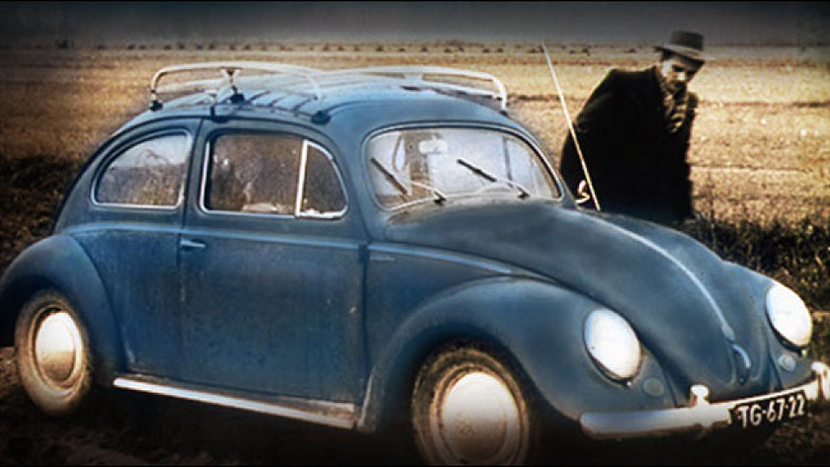
‘ordinary’ Brother Andrew

Slide 5
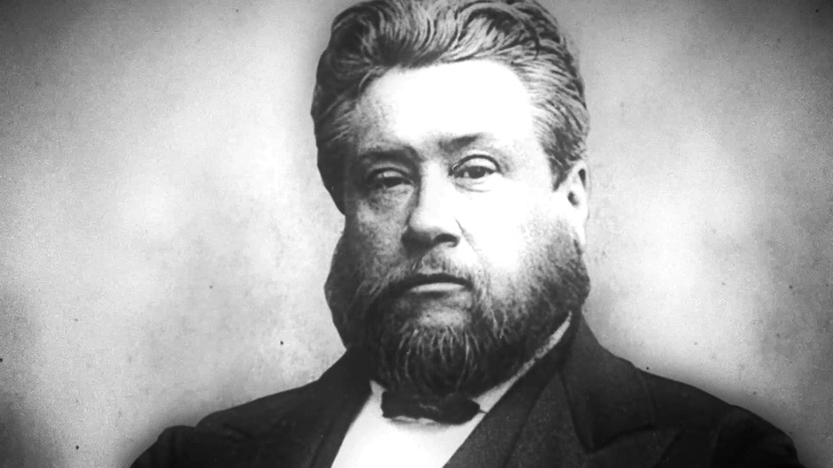
C.H. Spurgeon

Slide 6
Our ‘insignificant’ place=
God’s strategic placement
She said to her mistress, “Would that my lord were with the prophet who is in Samaria! He would cure him of his leprosy.”
2Kings5:3

Slide 7

An ordinary suffering servant points us to the extra-ordinary Suffering Servant

