Slide 1
How the good news came to corinth
Acts 18

Slide 2
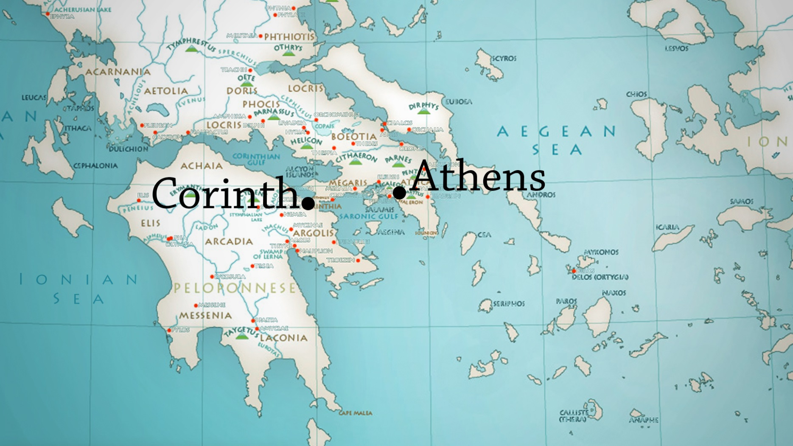
Location, location…

Slide 3
Acts 18
The longings of God
The ways of the Gospel
The obstacle to a Growing Church

Slide 4
v.1-2
After this Paul left Athens and went to Corinth. And he found a Jew named Aquila, a native of Pontus, recently come from Italy with his wife Priscilla

Slide 5
The Longings of God
“For I have many in this city who are my people.”
V.10

Slide 6
The ways of the Gospel
And he left there and went to the house of a man named Titius Justus, a worshiper of God. His house was next door to the synagogue.
v.7

Slide 7
The obstacle to a Growing Church
And the Lord said to Paul one night in a vision, “Do not be afraid, but go on speaking and do not be silent, for I am with you, and no one will attack you to harm you.
V.9

