Slide 1
Bellevue Chapel 09.02.20
What Qualifications Do I Need?
Matthew 9:35-10:23

Slide 3
Jesus went through all the towns and villages, teaching in their synagogues, preaching the good news of the kingdom and healing every disease and sickness. When he saw the crowds, he had compassion on them, because they were harassed and helpless, like sheep without a shepherd. Then he said to his disciples,
“The harvest is plentiful but the workers are few. Ask the Lord of the harvest, therefore, to send out workers into his harvest field.”
Matthew 9:35-38

Slide 4
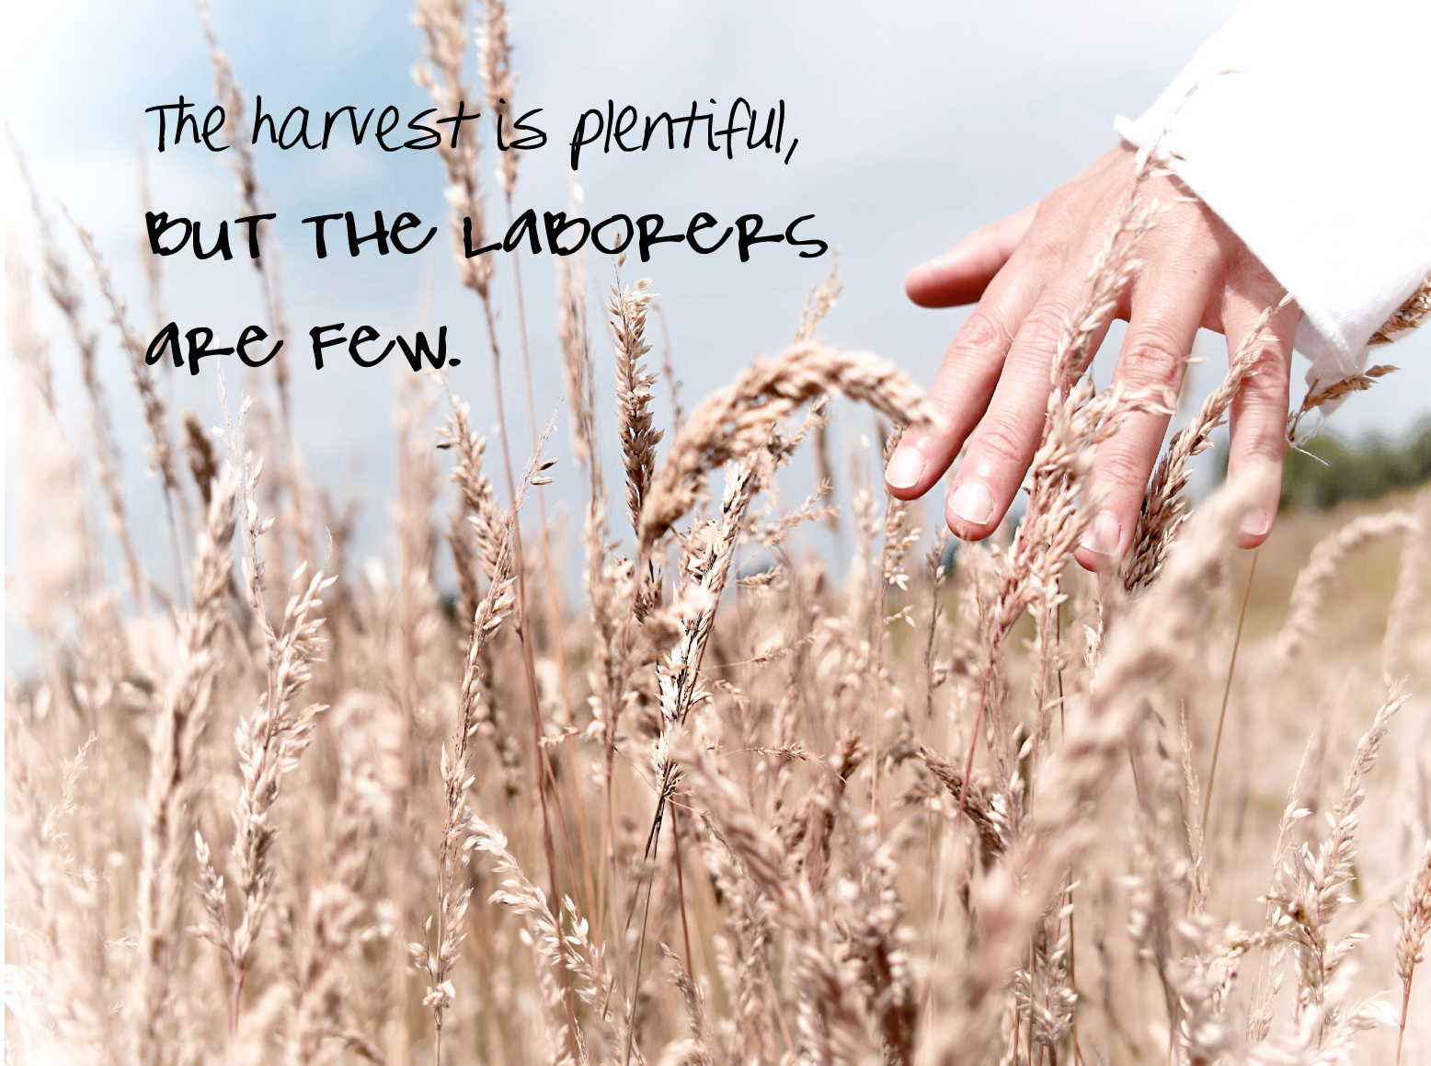

Slide 5
A Shortage Of Workers
In The Upside Down World Of The Kingdom Of God
Too Much Work
Not Enough Workers

Slide 8
We share a big vision – to work together towards the aim of Ending Homelessness in Scotland.

Slide 9
Vision – What Jesus Saw
When he saw the crowds, he had compassion on them, because they were harassed and helpless, like sheep without a shepherd. (verse 36)

Slide 10
Vision – What Jesus Saw
Vision = Seeing Things As They Really Are
Only Jesus Sees Things Perfectly
Everyone Else Suffers From Poor Sight

Slide 11
Vision – What Jesus Saw
“In the country of the blind, the one-eyed man is killed.”

Slide 12
Vision – What Jesus Saw
How Jesus Saw The Crowds
“Sheep Without A Shepherd”
“Harassed And Helpless”

Slide 13
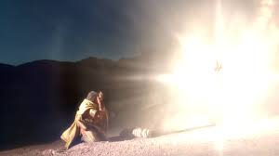
Vision – What Jesus Saw
How Do We See?
"Who are you, Lord?"
"I am Jesus, whom you are persecuting."

Slide 14
Vision – What Jesus Saw
How do we see?
The god of this age has blinded the minds of unbelievers, so that they cannot see the light of the gospel that displays the glory of Christ, who is the image of God. (2 Corinthians 4:4)

Slide 15
Vision – What Jesus Saw
How do we see?
A changed view of
Jesus
people
So from now on we regard no-one from a worldly point of view. Though we once regarded Christ in this way, we do so no longer. Therefore, if anyone is in Christ, he is a new creation; the old has gone, the new has come! (2 Corinthians 5: 16-17)

Slide 16
Compassion – What Jesus Felt
"When Jesus saw the crowds, he had compassion on them...“ (verse 36)
Jesus Moved By:
Sickness, Suffering And Death

Slide 17
Compassion – What Jesus Felt
Our Role Model
We do not have a high priest who is unable to sympathise with our weaknesses, but we have one who has been tempted in every way, just as we are – yet was without sin. (Hebrews 4:14)

Slide 18
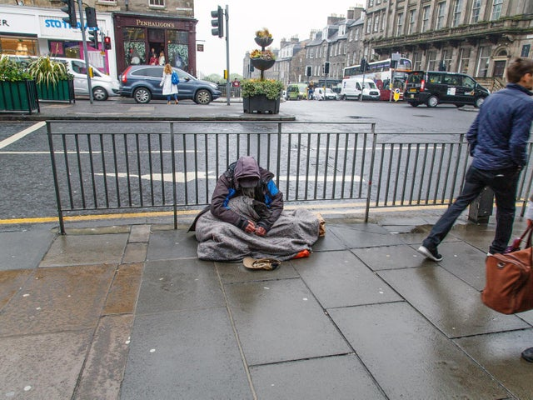

Slide 19
Intercession – What Jesus Commanded
“Ask the Lord of the harvest, therefore, to send out workers into his harvest field." (verse 38)

Slide 20
Intercession – What Jesus Commanded
Why Pray For Workers?
Because It Is Our Privilege
Because We Can Be Sure It Is God’s Will
Because It Places Our Dependence on God (Not Ourselves)

Slide 21
Intercession – What Jesus Commanded
Standing In The Gap
"I looked for a man among them who would build up the wall and stand before me in the gap on behalf of the land so that I would not have to destroy it, but I found none.” (Ezekiel 22: 30)

Slide 22
Intercession – What Jesus Commanded
The Result
God Sends Out Workers
God Changes Our Thinking
In the same way, the Spirit helps us in our weakness. We do not know what we ought to pray for, but the Spirit himself intercedes for us with groans that words cannot express. And he who searches our hearts knows the mind of the Spirit, because the Spirit intercedes for the saints in accordance with God's will. (Romans 8: 26-27)

Slide 23
Intercession – What Jesus Commanded
God Changes Our Thinking So That:
We See As He Sees
We Feel As He Feels
And Pray As He Commands
DO WE PRAY?

Slide 24
What Happened Next?
He called his twelve disciples to him and gave them authority to drive out evil spirits and to heal every disease and sickness. These are the names of the twelve apostles: first, Simon (who is called Peter) and his brother Andrew; James son of Zebedee, and his brother John; Philip and Bartholomew; Thomas and Matthew the tax collector; James son of Alphaeus, and Thaddaeus; Simon the Zealot and Judas Iscariot, who betrayed him.
These twelve Jesus sent out....
Matthew 10:1-5

Slide 25
