Slide 1
Live by the Spirit
(Spirit filled, Spirit empowered, Spirit led, just like Jesus)
"knowing the Spirit as the power to witness"
Bellevue Chapel -14th May 2017
Notes:
Tonight we’re continuing in your series entitled “Live by the Spirit”. I really like and am going to refer often to the subtitle, “Spirit filled, Spirit empowered, Spirit led, just like Jesus”.
Tonight’s specific topic is, “knowing the Spirit as the power to witness.”

Slide 2
Notes:
I was helpfully sent a main text and a number of Bible references relevant to tonight’s subject. Lets look at the passage containing the main text for tonight. This is Acts 1:6-9.

Slide 3
Acts 1 NIV (2011)
⁶Then they gathered around him and asked him, “Lord, are you at this time going to restore the kingdom to Israel?”
⁷He said to them: “It is not for you to know the times or dates the Father has set by his own authority.
⁸But you will receive power when the Holy Spirit comes on you; and you will be my witnesses in Jerusalem, and in all Judea and Samaria, and to the ends of the earth.”
⁹After he said this, he was taken up before their very eyes, and a cloud hid him from their sight.
Empowered
Filled
Led
Notes:
As you’re probably aware, the occasion is Jesus with his disciples after his unexpected (by them!) resurrection. Unlike before, they’re now fully aware that he is the long awaited messiah. So quite understandably, they assume that he’s now going to do what they always hoped he would. >>>
He kindly but firmly reminds them that dates and times are the Father’s business alone! >>>
BUT they have a much, much more important role than they ever imagined. And because their role is so important, they will receive the Holy Spirit, just as he had explained so clearly to them before his passion. Their role will to be witnesses to Jesus, to be his representatives, not only to Jewish people but to the whole world. Wow!!!
I’ve used colour here to highlight the phrases which carry the key meanings. Bold BLACK for the Divine input, “when the Holy Spirit comes on you.” Bold RED for what He will provide, “you will receive power” - the enabling which will be required! Bold BLUE for what the Spirit will lead them to do, “you will be my witnesses”. And bold GREEN for where the Spirit will lead them, “to the ends of the earth”. >>> FILLED >>> EMPOWERED >>> LED - JUST LIKE JESUS!!! >>>
And as this was all just recapping what he had already told them, he ascended into heaven – before their very eyes!
It’s over to you now ladies and gentlemen. Of course he had already told them to wait for the Holy Spirit to come.
But why the waiting when the task is so urgent? Why could the Spirit not just have come as Jesus left? Well – see verse 7, for a start!
So from Acts 1:8, our text for today, we can see that our crucial role of being “his witnesses“ necessitates being FILLED, EMPOWERED and LED by THE HOLY SPIRIT.

Slide 4
Notes:
As we read through the record, in Acts and the rest of the New Testament, of how these early believers went on to follow Jesus‘ instructions, we see these 3 principles being worked out.
I now want to briefly look at some passages which illustrate this. Most of these are references I was given, but I personally benefited from tracing these themes throughout the NT. We just don’t have time to look at more!

Slide 5
Filled by the Spirit:
Acts 4:
⁸Then Peter, filled with the Holy Spirit, said to them: “Rulers and elders of the people!
³¹After they prayed, ... they were all filled with the Holy Spirit and spoke the word of God boldly.
Acts 6:
⁵ ... They chose Stephen, a man full of faith and of the Holy Spirit;
Acts 11:
²² ... they sent Barnabas to Antioch. ... ²⁴He was a good man, full of the Holy Spirit and faith, and a great number of people were brought to the Lord.
Notes:
The phrase, “filled by the Spirit” or “full of the Holy Spirit” occurs frequently in Acts.
>>>
In Acts 4, as Peter and John are before the Jewish High Council being investigated for healing a lame man at the gate of the temple, we read in verse 8: “⁸Then Peter, filled with the Holy Spirit, said to them: “Rulers and elders of the people!” Clearly a fulfilment of Jesus’ promise in Mark 13:11, “Whenever you are arrested and brought to trial, do not worry beforehand about what to say. Just say whatever is given you at the time, for it is not you speaking, but the Holy Spirit.“
>>>
After Peter and John had been released, having been told not to speak publicly about Jesus, they met with the other believers and prayed, in v31 we read of another filling of the Holy Spirit!
>>>
In Acts 6 when a number of believers are selected to to act as Deacons, we read
In verse 5 that one of them, Stephen was, “full of the Holy Spirit”. (Although verse 3 says, “Brothers and sisters, choose seven men from among you who are known to be full of the Spirit and wisdom.“)
>>>
In Acts 11, when we are introduced to Barnabus, a man who is clearly an effective evangelist, he is described as, “full of the Holy Spirit”!
As I searched through the NT looking at the many times individuals were described as “filled with” or “full of” the Holy Spirit I wondered, ‘did this mean that only some people were filled?’ But look again at Acts 4:31.
>>>
“They were ALL filled”!!!

Slide 6
Empowered by the Spirit:
Acts 6:
⁸Now Stephen, a man full of God's grace and power, performed great wonders and signs among the people. ⁹Opposition arose, ... from ... Jews ... who began to argue with Stephen. ¹⁰But they could not stand up against the wisdom the Spirit gave him as he spoke.
1 Thessalonians 1:
⁵ ... our gospel came to you not simply with words but also with power, with the Holy Spirit and deep conviction. You know how we lived among you for your sake.
Notes:
Now looking at some examples of how the Christian’s fulfilled Christ’s command to spread the message about him, we see references like:
>>>
Back in Acts 6 we have further references to Stephen. In verse 8, he is described as, “full of God‘s grace and power”. A phrase that I believe is synonymous with being, “full of the Spirit”. As ever, there is plenty of opposition to the message and thus to its messenger. Notice that in v10, we read that his detractors, “could not stand up against the wisdom the Spirit gave him.” This, again reminds us that the “empowering” of the Spirit is displayed in many different ways.
>>>
When writing to the believers in Thessalonica, Paul says in 1 Thess 1:5
“our gospel came to you not simply with words but also with power, with the Holy Spirit and deep conviction. You know how we lived among you for your sake.”
Here it might seem that “power” and “deep conviction” are separate from “the Holy Spirit” but I don’t think that’s what Paul is saying. The “power” is the Spirit’s and it He who brings the “deep conviction“. Remember Jesus‘ words in John 16:
“⁸When he comes, he will prove the world to be in the wrong about sin and righteousness and judgment: ⁹about sin, because people do not believe in me; ¹⁰about righteousness, because I am going to the Father, where you can see me no longer; ¹¹and about judgment, because the prince of this world now stands condemned.”

Slide 7
Led by the Spirit:
Acts 8:
²⁹The Spirit told Philip, “Go to that chariot and stay near it.”
... Philip baptised him. ³⁹When they came up out of the water, the Spirit of the Lord suddenly took Philip away
Acts 13:
²While they were worshiping the Lord and fasting, the Holy Spirit said, “Set apart for me Barnabas and Saul for the work to which I have called them.” ³So after they had fasted and prayed, they placed their hands on them and sent them off.
Notes:
Again there are plenty of NT references to the LEADING of the Holy Spirit in the ongoing work of witness, or evangelism as we usually refer to it today. >>>
In Acts 8, Philip is led by the Spirit in a number of ways. In V 29, the Spirit SPEAKS to him to tell him where to go and what to do. Was this an audible voice or not – we don’t know!
After Philp has explained the scriptures to the travelling foreign dignitary he asks to be baptised. >>>
Then the Holy Spirit transports him away – no ticket or seat apparently required.
>>>
In Acts 13
The church in Antioch is meeting together. “²While they were worshiping the Lord and fasting, the Holy Spirit said, “Set apart for me Barnabas and Saul for the work to which I have called them.” ³So after they had fasted and prayed, they placed their hands on them and sent them off.
Here again, the Holy Spirit LEADS by “speaking”! He chooses who he wants to be specially commissioned evangelists. Interestingly it’s “Spirit filled” Barnabus and his (then) junior partner Saul, better known as the apostle Paul.
Later (e.g. In Acts 16) we read of Paul and his colleagues being led, first by the Spirit blocking their plans and then directing them in another way.

Slide 8
Notes:
Of course, these themes of being FILLED, EMPOWERED and LED by the Holy Spirit recur throughout the New Testament. I just want to look in a little more detail at one of them.

Slide 9
Filled by the Spirit?
Notes:
Considering these things over the last few weeks has simply re-affirmed my view that the key to living as Jesus calls us to is to be “Filled by the Spirit” or perhaps more Biblically, Filled with the Spirit”. But what does this mean and how are we to understand it?
>>>
A common way in which Filling by/or/with the Holy Spirit is described is by a picture of a vessel containing some liquid. Being filled is pictured, understandably, as a full vessel – often so that it runs over. This is not an incorrect picture but perhaps its not as helpful as it might be.

Slide 10
Notes:
As I’ve been reflecting on this I came across what I feel is a very helpful presentation of what “Filling of the Spirit” means.
>>> It says:
“Filling of the Spirit is defined as the spiritual state where the Holy Spirit is continually fulfilling all that he came to do in the >>> heart and mind of the believer.”
“It is not a matter of acquiring more of the Spirit, but rather of the Spirit of God acquiring all of the individual!”
“In the present age this is the normal, if not usual experience of every believer.”
It is commanded for every believer, (Eph 5:18) – to not be is at least partial disobedience.”
Yes, John, of course, this is helpful but I’m still confused!
So, as I’ve been thinking and praying, I’ve been asking myself this question, “These people we’ve read about who were “filled with” or “full of” the Holy Spirit - what would that look like?” Wouldn’t it be that they looked like Jesus? After all, He was filled with the Spirit - remember Christiaan’s first sermon in this series! What does it mean to “look like Jesus”? Surely, it means that the person thinks like Jesus, speaks like Jesus, acts like Jesus. How can we be like that? I don’t think it’s just a passive thing. Surely we seek the Spirit’s help to become more like Jesus – in every respect. We actively think, what would Jesus think about this, what would he say and how would be act. And if we live like this, the Holy Spirit will be willing to transform and guide us.

Slide 11
Notes:
According to Galatians 5:22-23, these are the fruits of the Spirit, so I assume that’s what a Spirit filled person looks like!

Slide 12
“be filled with the Spirit":
Eph 5:
¹⁵ Be very careful, then, how you live - not as unwise but as wise, ¹⁶ making the most of every opportunity, because the days are evil. ¹⁷ Therefore do not be foolish, but understand what the Lord's will is.
¹⁸ Do not get drunk on wine, which leads to debauchery. Instead, be filled with the Spirit, ¹⁹ speaking to one another with psalms, hymns, and songs from the Spirit. Sing and make music from your heart to the Lord, ²⁰ always giving thanks to God the Father for everything, in the name of our Lord Jesus Christ.
Notes:
Lets take a moment to look at the command “be filled with the Spirit” in Ephesians 5:18 in its context. This passage has enough material for a complete sermon but we don’t have time for that! But is worth reading for its highly practical instruction.
>>>
“¹⁵ Be very careful, then, how you live - not as unwise but as wise, ¹⁶ making the most of every opportunity, because the days are evil. ¹⁷ Therefore do not be foolish, but understand what the Lord's will is.”
>>>
¹⁸ Do not get drunk on wine, which leads to debauchery. Instead, be filled with the Spirit, ¹⁹ speaking to one another with psalms, hymns, and songs from the Spirit. Sing and make music from your heart to the Lord, ²⁰ always giving thanks to God the Father for everything, in the name of our Lord Jesus Christ.
Clearly, being filled with the Spirit is a choice – for us to make. There are alternative choices.

Slide 13
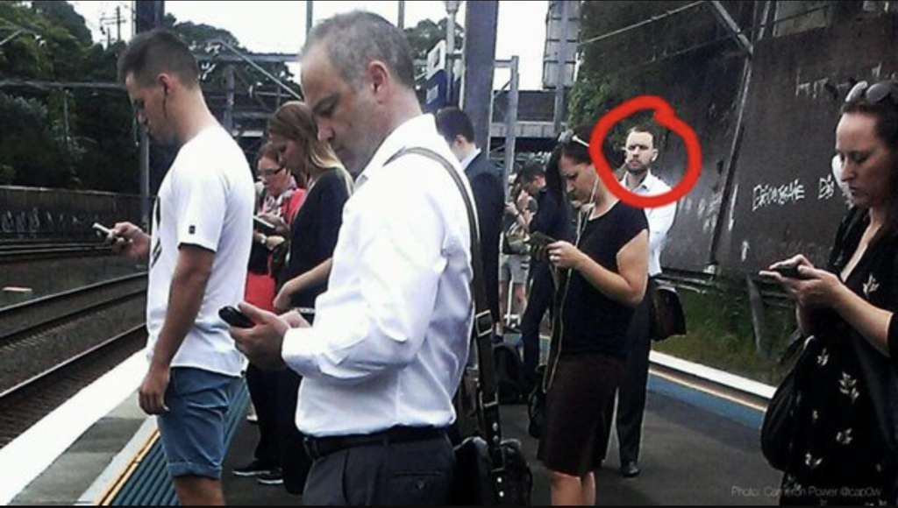
Notes:
Paul’s reminder that we have a choice over what controls and motivates us is highly relevant today. But we have perhaps subtly different distractions today.
>>>
Look at this picture. Do you know why only this man is circled with red in this picture of commuters on a train platform. Yes, its because he’s the only person on the platform not staring at a smartphone!!!

Slide 14
Notes:
I travelled into Waverley station by bus on Wednesday morning at 8.30am this week. As I looked round I was struck by how almost everyone on the lower deck was staring intently at their smartphone and loving scrolling through its pages. More surprising they weren’t all young people either.
Traveling by public transport used to be a good way to speak to people – well maybe not as easy in Edinburgh as in the rest of the world. But now there is no eye contact and no talking – unless people are using their phone to talk to someone!
But this staring at screens is not restricted to travellers. People walking along the street, sitting in restaurants, families at home are all isolated by technology. If you’re young, you’ll tell me that you’re communicating with all your vast numbers of ‘friends’. But Texts, Twitter, Whatsapp, Instagram and Facebook posts often mean that our communication is superficial and limited.
Of course, my smartphone contains 15 Bible translations, a whole Bible reference library of commentaries, dictionaries and maps I could never have shelf space in my house for. And even better, they are all searchable and cross referenced so I can study the scriptures in a way hardly possible in the past. I can also use it anytime with no network connection and I always have it with me. It’s the main reason I have had a pocket electronic device as long as they’ve been available. BUT – am I still tempted to spend too much time keep up on the news, or surfing the web or anything else which distracts me from becoming more like Jesus.

Slide 15
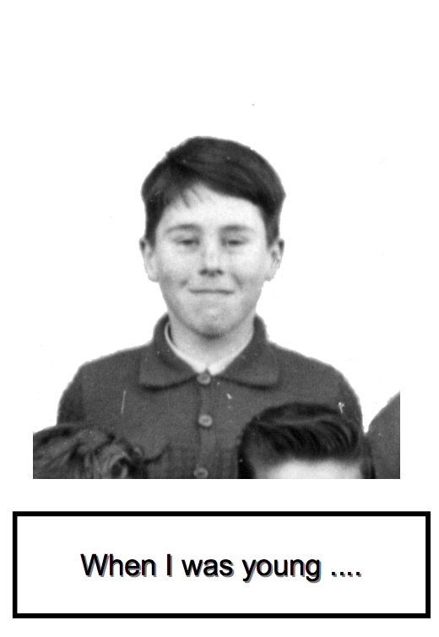
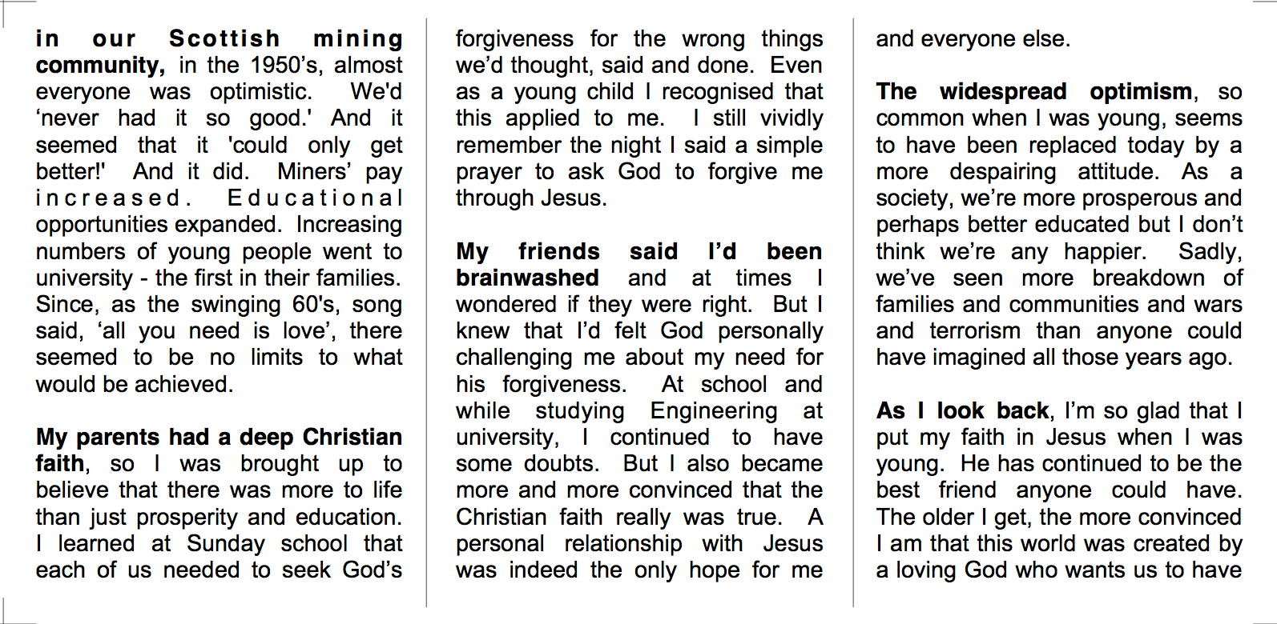
Personal Tract ?
Notes:
Of course we can use technology to communicate the Gospel – Try Praying is a great example of this. But what else can we do? In the past, people gave our tracts. That never was easy and the available material can be pretty cringe worthy! Why not write your own?
>>>
What write a “Personal Tract”? About 9 years ago we did a
>>>
”Blowing Your Cover” evangelistic course at Ferniehill. Part of the course encouraged us to write our own Tract. I was leading the course so had to do it! >>>
This was my attempt. Its very small and easy to keep some in your pocket.
>>>
Its just a simple fold over double-sided leaflet. Cheap and easy to produce and print. I found it was surprisingly easy to give it away on public transport and social events – especially when getting up to go. Of course, this will be much harder today as your fellow travellers will be starting at their screen. However, in some situations where you do get to chat to a stranger, its surprisingly easy to say, “would you like a copy of a little leaflet I wrote?” Yes, that’s me on the front when I was about 10 at Primary School. Its just a little story about my life.” People usually take it!

Slide 16
Notes:
I believe that if we are filled with the Spirit, then His power will enable us and lead us to opportunities to witness to/for Jesus. He will bring us into contact with the people whose lives He is already working in.

Slide 17
Notes:
A VERY challenging question. But one we need to keep asking ourselves. The exciting news, is that The Spirit longs to fill us!

Slide 18
Thinking and responding:
am I allowing The Spirit to fill me?
how like Jesus am I?
is He the focus of my life?
am I trusting Him for power?
am I willing to be led by Him?
Notes:
So, as we conclude, lets think and respond:
>>> “Am I allowing The Spirit to fill me?” To completely direct every aspect of my life!
>>> “How like Jesus am I?” That’s how I and others should be able to discover how filled with the Spirit I am!
>>> “Is He the focus of my life?” – If I really love Him, I will want to be like Him. And if I look to Him then I will become like Him!
>>> “Am I trusting Him for power?” – The Holy Spirit is the Spirit of Jesus and His power is available to us! (Power vs manual screwdriver?)
>>> “Am I willing to be led by Him?” – The Spirit wants to lead us – am I open to His leading?
Spirit FILLED, EMPOWERED, LED – JUST LIKE JESUS!

