Slide 2
Our Vision:
“Helping to create
a mission movement
across Edinburgh.”

Slide 3
Our Mission Statement:
“Stimulating and strengthening
the church’s mission
in Edinburgh.”

Slide 4
Foodbank+ Network
Bruntsfield Evangelical Church, Bruntsfield
Wilson Memorial Church, Craigentinny
Granton Baptist Church, Granton
Ebenezer United Free Church, Leith
Tron Kirk Gilmerton & Moredun Church, Moredun
Community Church Edinburgh, Newington
(supported by Newington Churches Together)
Lighthouse Central Church, Prestonpans
Citizens Advice Edinburgh
Energy Advice and Support project
Working with 60+ Referral Agencies

Slide 5
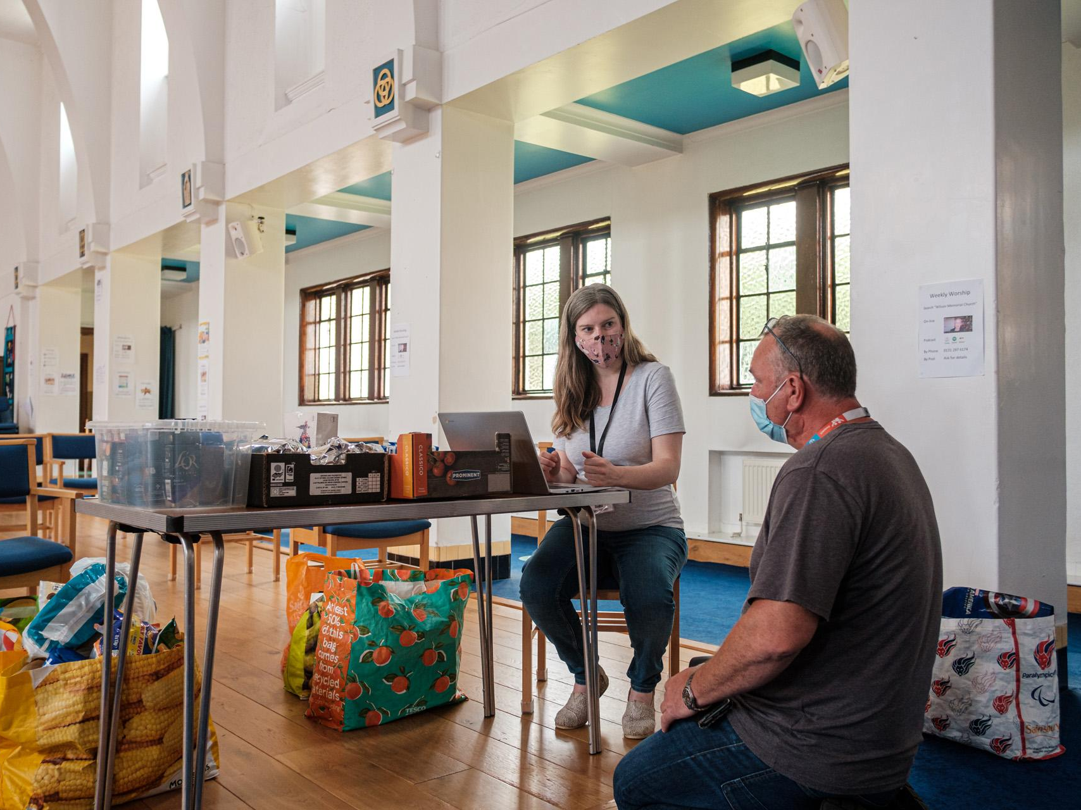

Slide 6
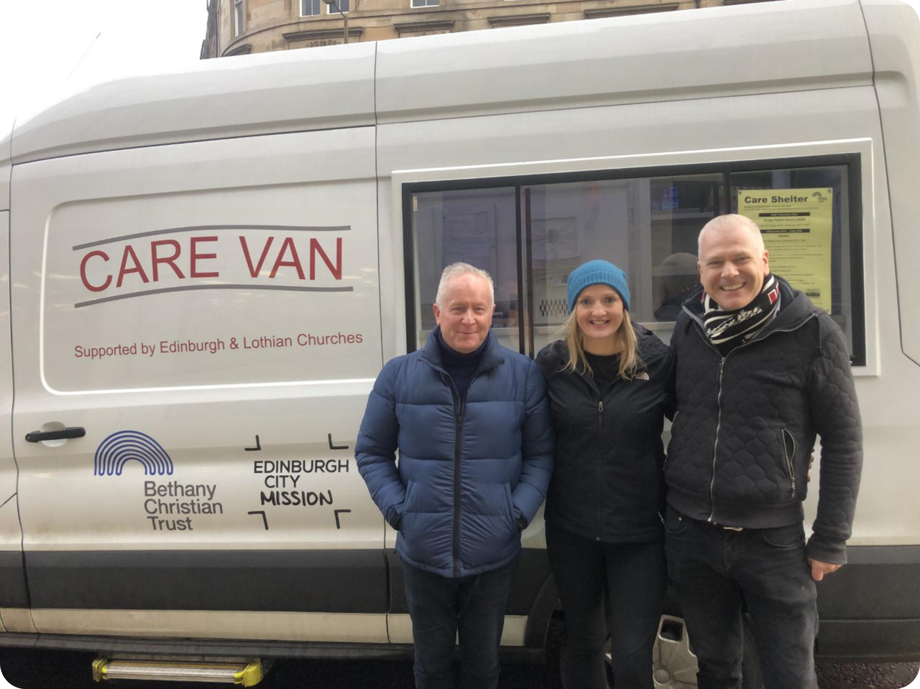
The Care Van
Edinburgh City Mission (evening rota – 7 days/week)
Bethany Christian Trust (lunch-time rota – 5 days/week)
40 Edinburgh and the Lothians Churches

Slide 7
Initiated in 2020
Salaam for refugees and asylum seekers
Soul Food Edinburgh at Carrubbers
The Storehouse food storage and distribution centre – approx. £1,000 per week on food
Clothesbank+with Central Church, Tollcross

Slide 8
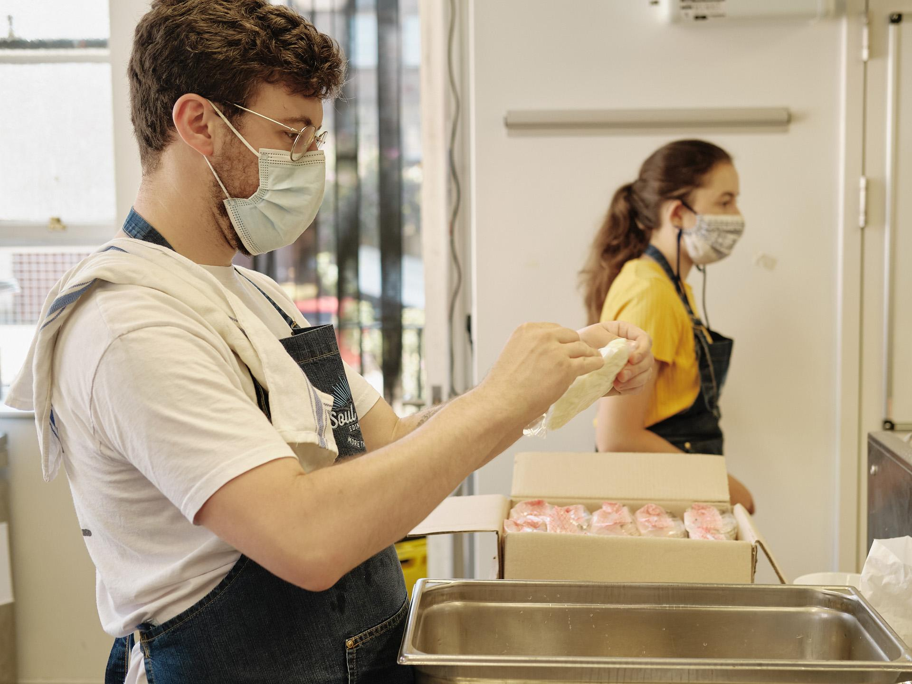

Slide 9
Initiated in 2021
An Open Hand toy delivery service
Greenbank Parish Church, Morningside
Salaam: Afghan support
Peaced Together
Salaam Weekend Club
Nations support for ethnic minority churches

Slide 10
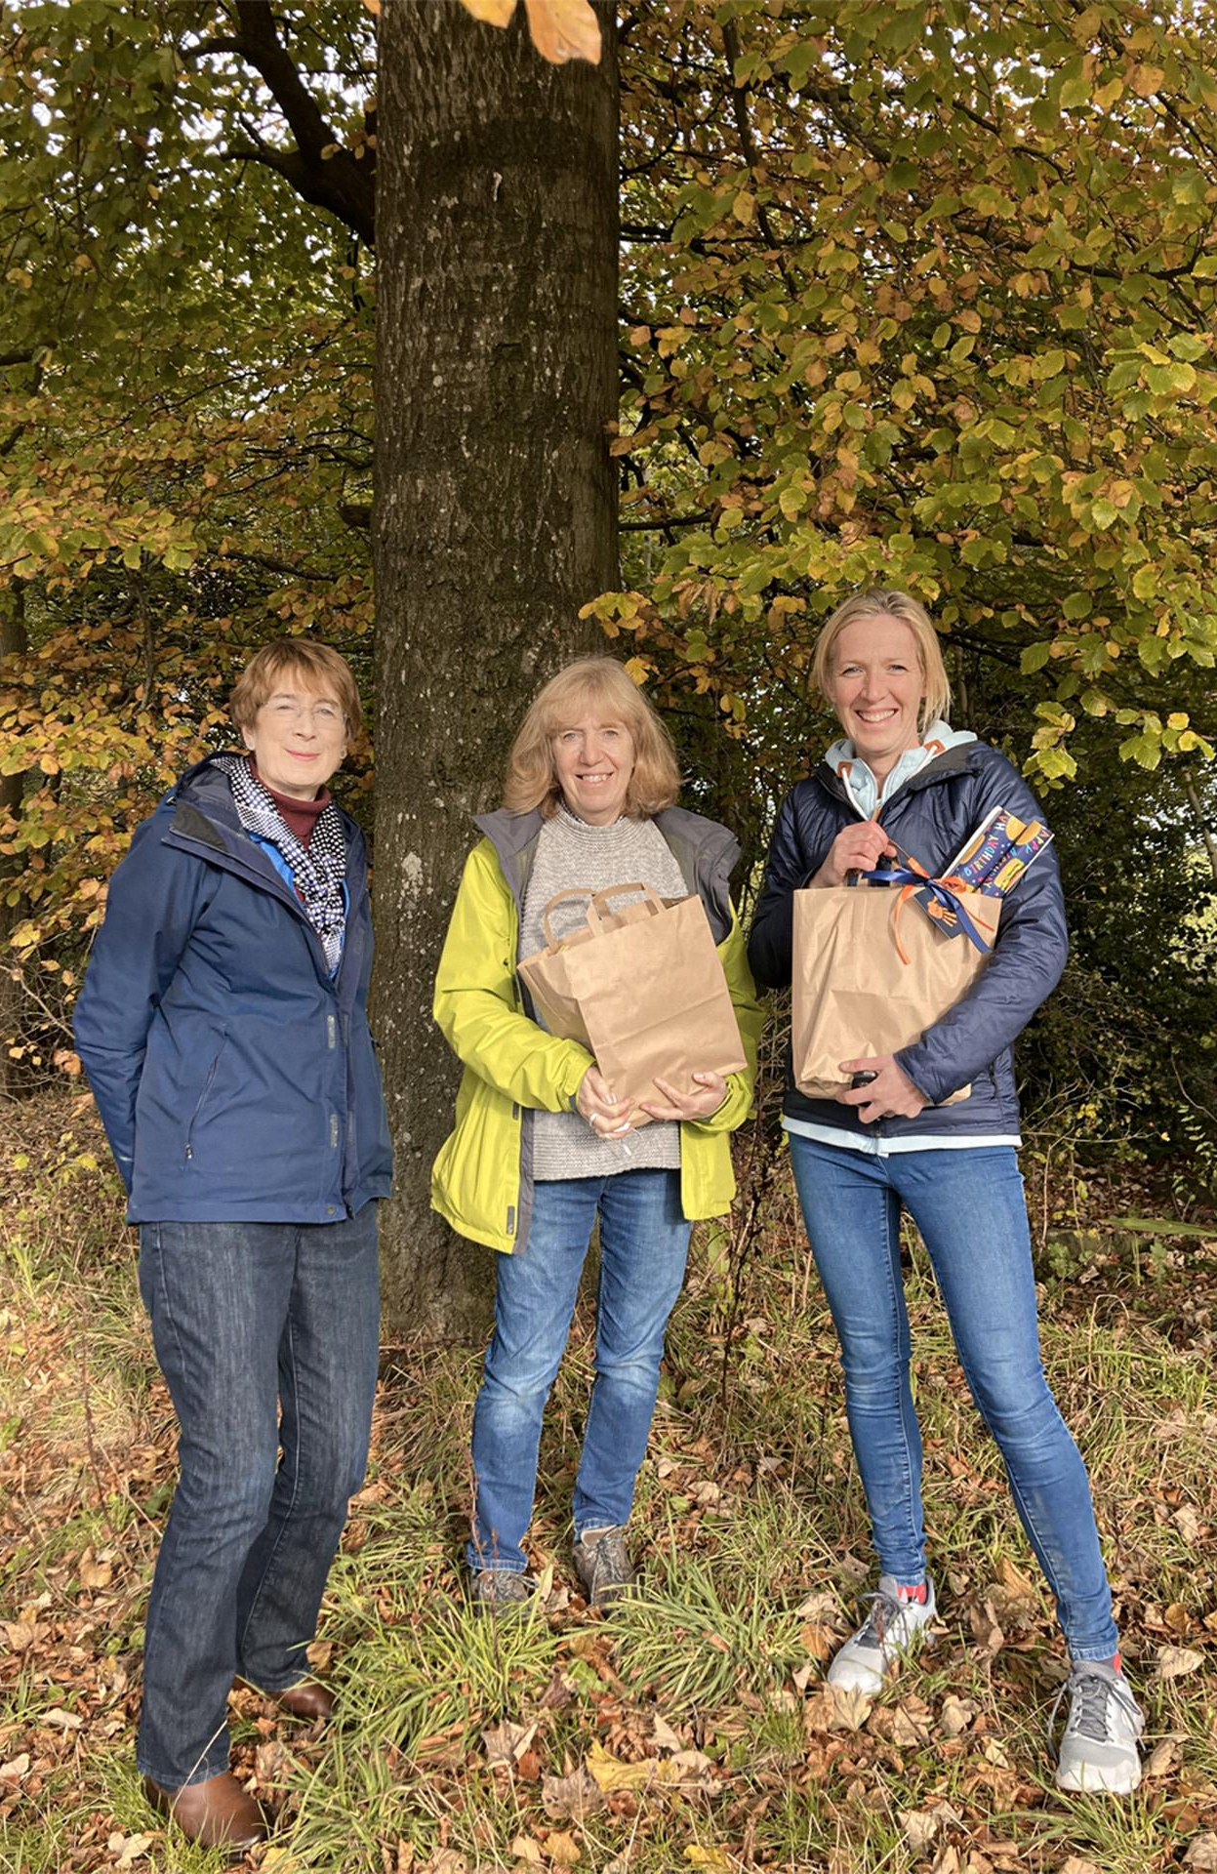

Slide 11
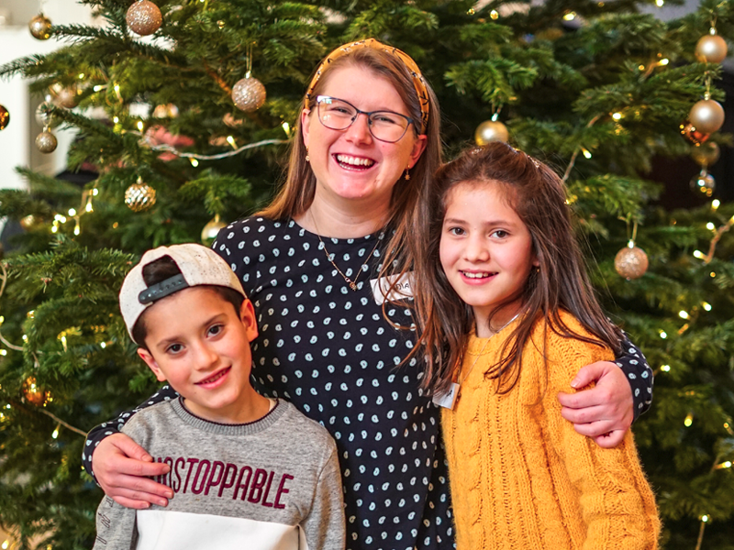

Slide 12
Initiated in 2022
Two’s Company with Linking Lives
Ukrainian refugee support
“Hope on the Move” food van
The Coffee Project with Stenhouse Baptist Church, GDS Parish Church & Junction 42

Slide 14
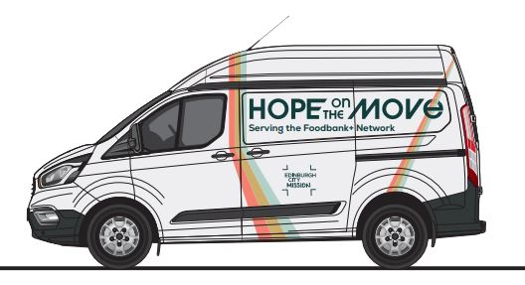

Slide 15
Launching in 2023
Community Catalyst prayer meetings
Kids Matter parenting course
Salam English Café with Abbeyhill Baptist Church and The Mustard Seed
Restless for Mission on 18th February 2023

Slide 16
