Slide 1
A new heaven and a new earth
Isaiah 65:17-66:2

Slide 2
Really?

Slide 3
Isaiah 65:17
See, I will create new heavens
and a new earth.

Slide 4
Hear this as exiles

Slide 5
Be moved by the extent of God’s mercy
But be glad and rejoice forever in what I will create, for I will create Jerusalem to be a delight and its people a joy. V.18

Slide 6
C.S. Lewis

Slide 7
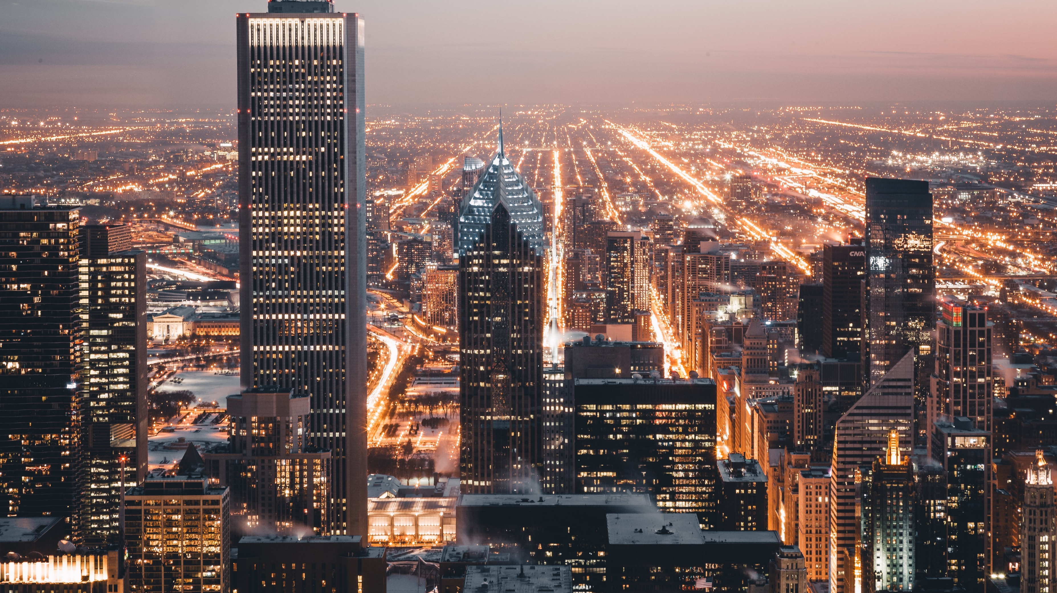
A new jerusalem

Slide 8
Transformed prayer
Before they call I will answer; while they are still speaking I will hear. V.24

Slide 10
We can be confident
Heaven is my throne, and the earth is my footstool. Where is the house you will build for me? Where will my resting place be? Has not my hand made all these things, and so they came into being?” declares the Lord. Is.66:1-2a

Slide 11
These Gospel realities change us
They:
Comfort us
Awaken us
Humble us
These are the ones I look on with favour: those who are humble and contrite in spirit, and who tremble at my word. V.2

Slide 12
Marble Caves

