Slide 1
The Good Shepherd
John 10

Slide 2
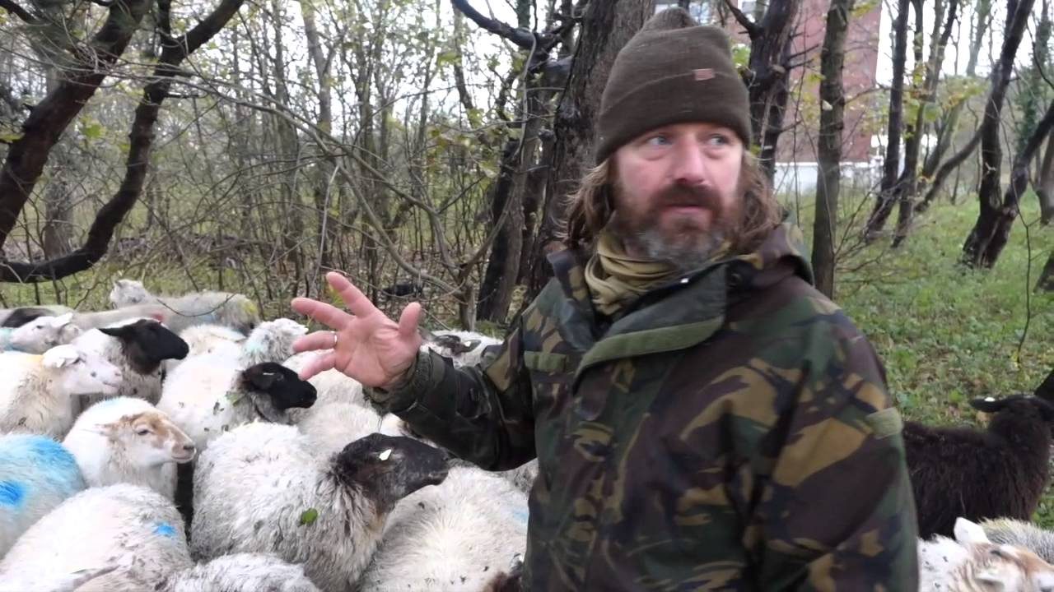

Slide 3
John 10:14
I am the good shepherd. I know my own and my own know me

Slide 4
John 10:3
The sheep hear his voice, and he calls his own sheep by name and leads them out.

Slide 5
John 10:11
I am the good shepherd. The good shepherd lays down his life for the sheep.

Slide 6
John 10:12-13
He who is a hired hand and not a shepherd, who does not own the sheep, sees the wolf coming and leaves the sheep and flees, and the wolf snatches them and scatters them. He flees because he is a hired hand and cares nothing for the sheep.

Slide 7
John 10:7
So Jesus again said to them, “Truly, truly, I say to you, I am the door of the sheep.

Slide 8
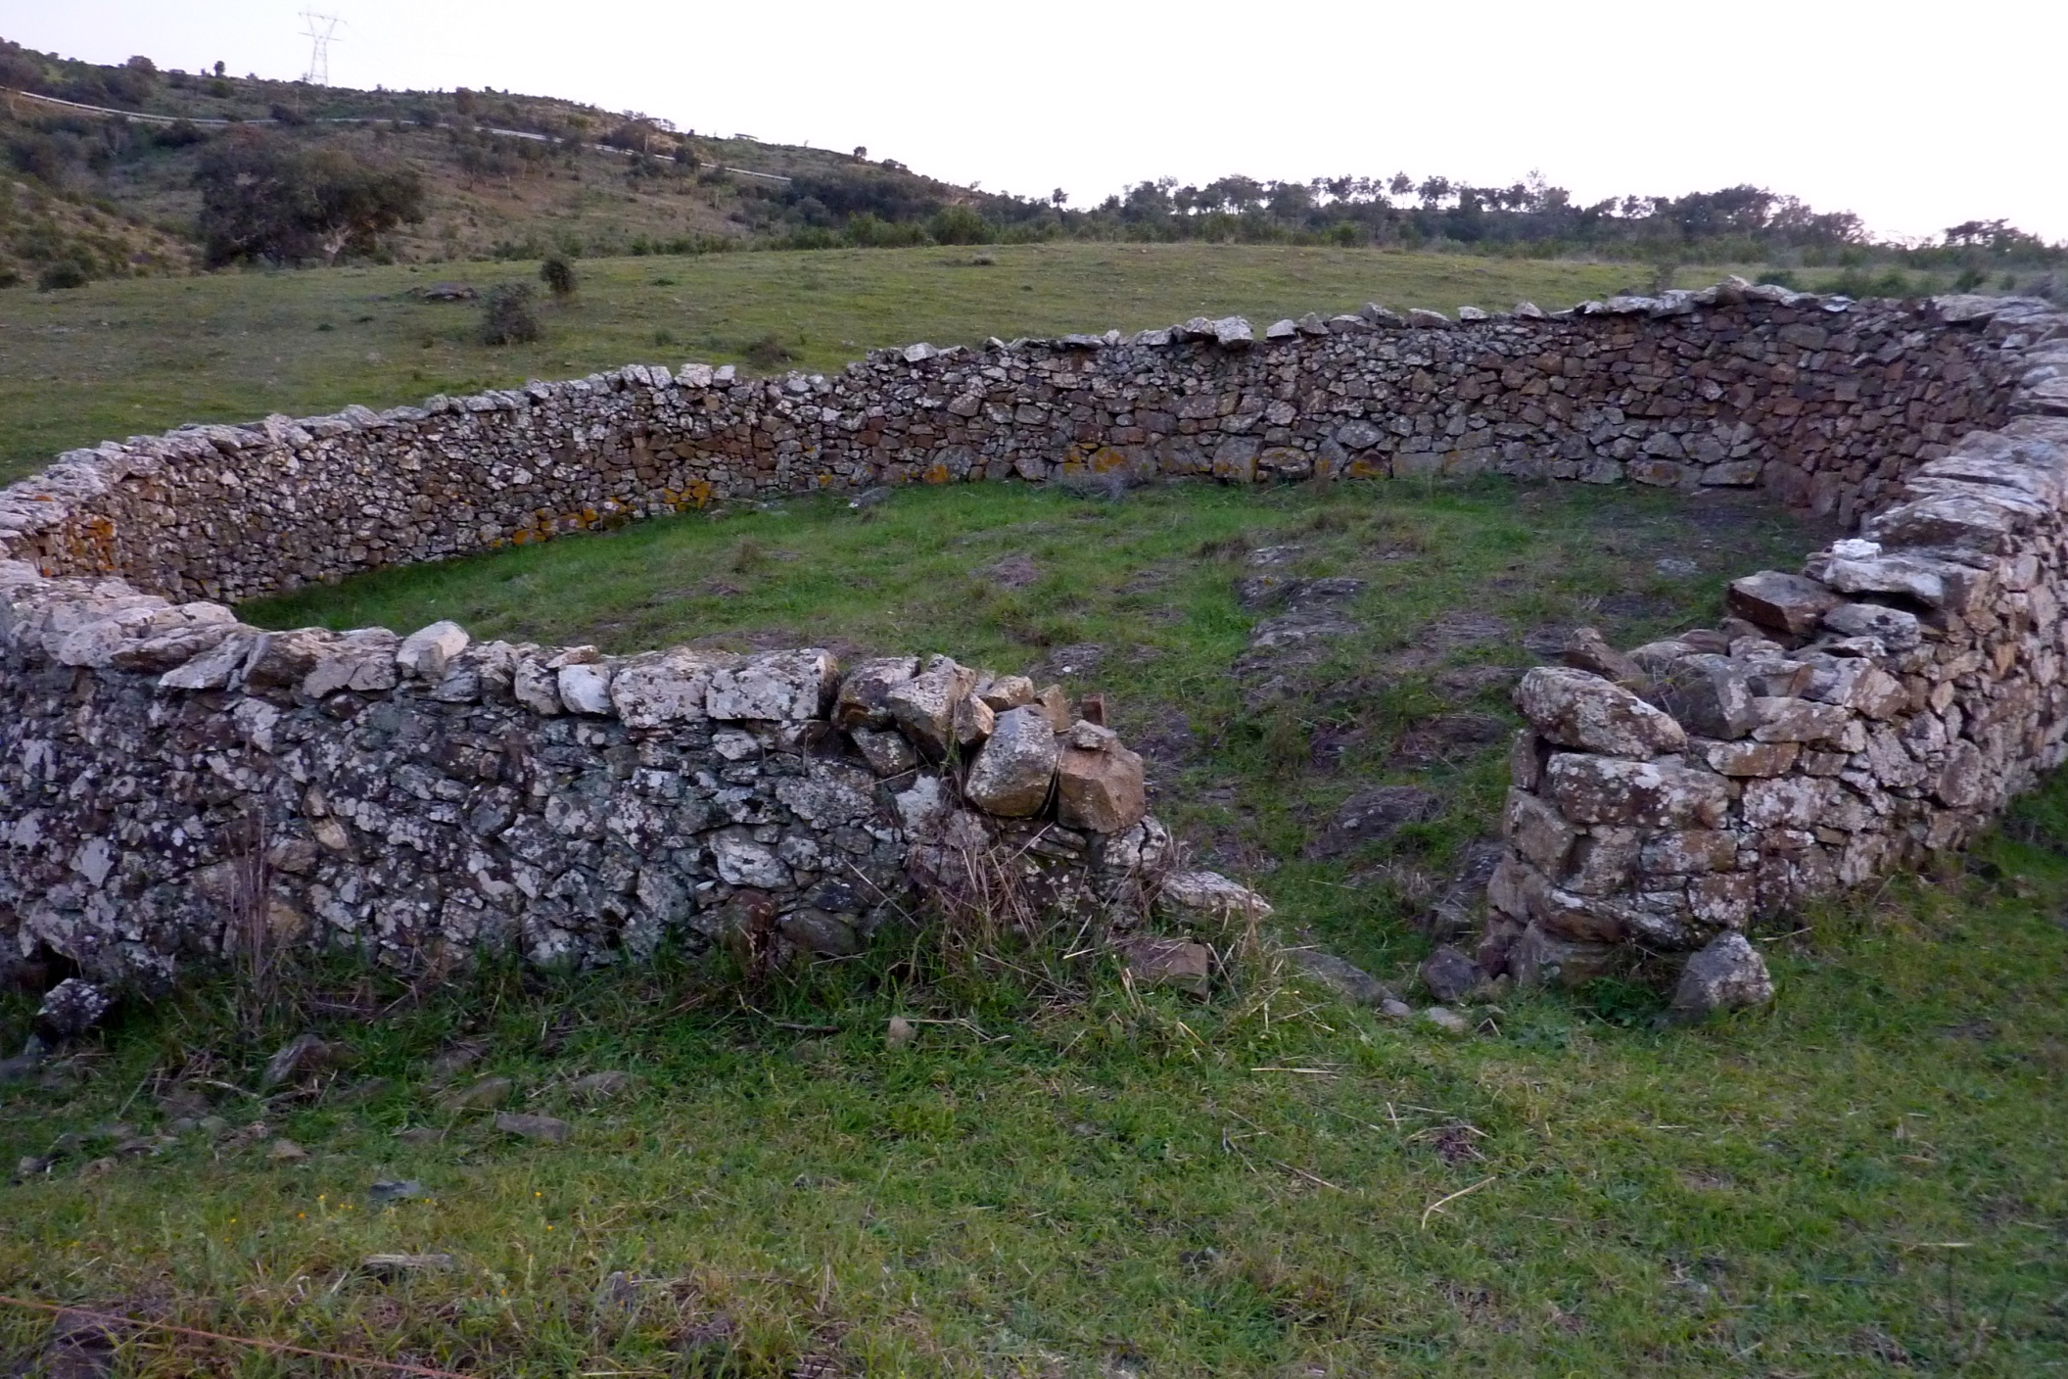

Slide 9
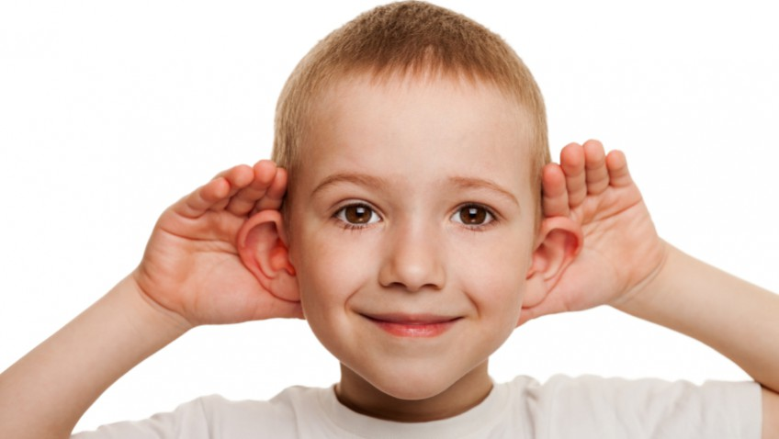
Today if you hear His voice…

