Slide 1
Like Father like Son
John 5

Slide 2

“I am a stable genius”

Slide 4
Jesus’ 2 claims:
The Son of God
The Judge

Slide 5

Dependent…

Slide 6
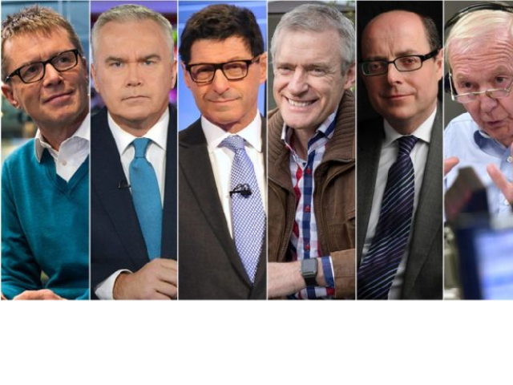
Equal…

Slide 7

At work…
As a father shows compassion to his children, so the Lord shows compassion to those who fear him. Psalm 103:13

Slide 8
Honour the Son
that all may honour the Son, just as they honour the Father. Whoever does not honour the Son does not honour the Father who sent him. John 5:23

Slide 9
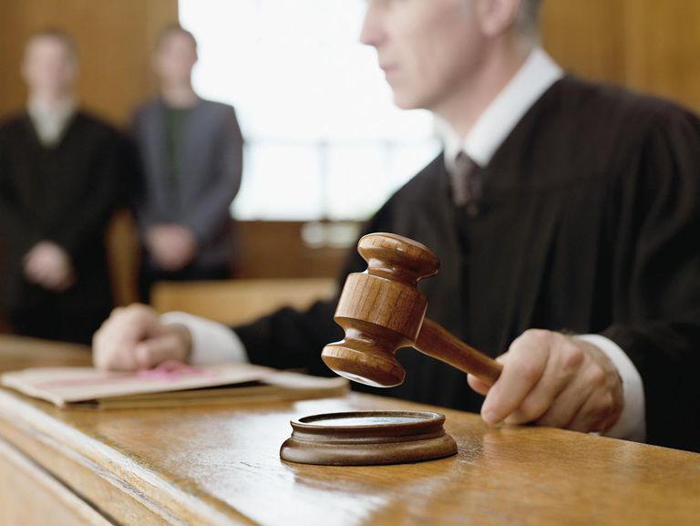
Jesus: the Judge

Slide 10
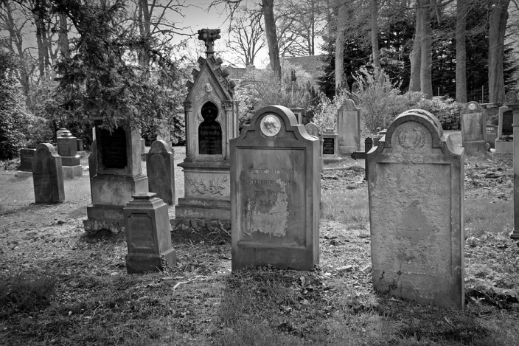
A future judgment
an hour is coming when all who are in the tombs will hear his voice John 5:28

Slide 11

Jesus saves!
For as the Father raises the dead and gives them life, so also the Son gives life to whom he will. John 5:21

Slide 12

“I am trying here to prevent anyone saying the really foolish thing that people often say about Him: I’m ready to accept Jesus as a great moral teacher, but I don’t accept his claim to be God. That is the one thing we must not say. A man who was merely a man and said the sort of things Jesus said would not be a great moral teacher. He would either be a lunatic — on the level with the man who says he is a poached egg — or else he would be the Devil of Hell. You must make your choice. Either this man was, and is, the Son of God, or else a madman or something worse. You can shut him up for a fool, you can spit at him and kill him as a demon or you can fall at his feet and call him Lord and God, but let us not come with any patronizing nonsense about his being a great human teacher. He has not left that open to us.”

