Slide 1
Encountering God
Leviticus 9:1-24

Slide 2
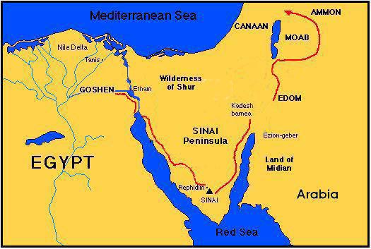

Slide 3


Slide 4
Leviticus 9:6
And Moses said, “This is the thing that the Lord commanded you to do, that the glory of the Lord may appear to you.”

Slide 5
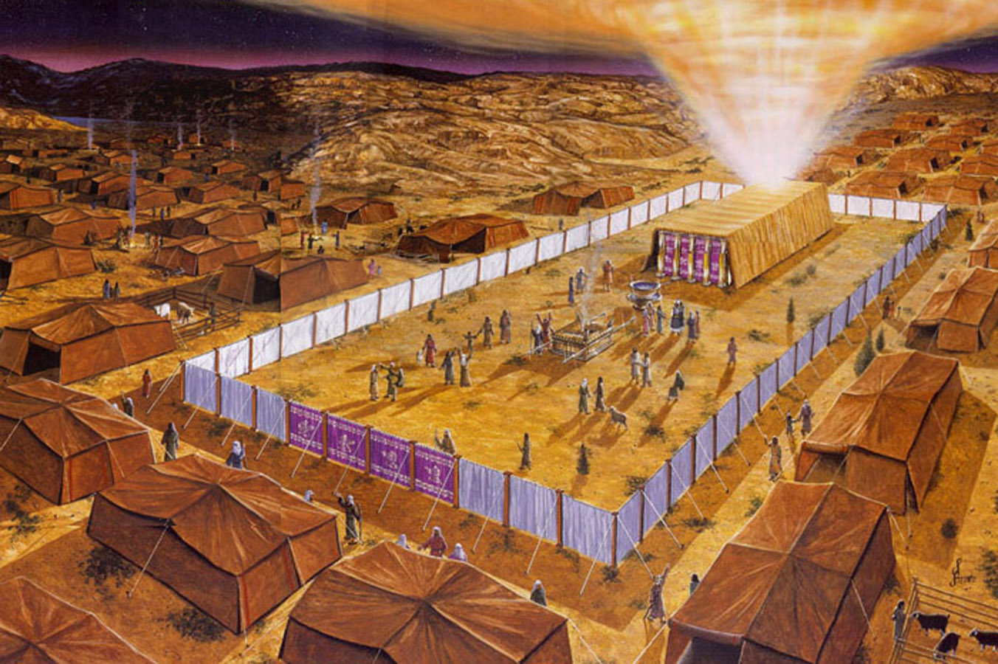

Slide 6
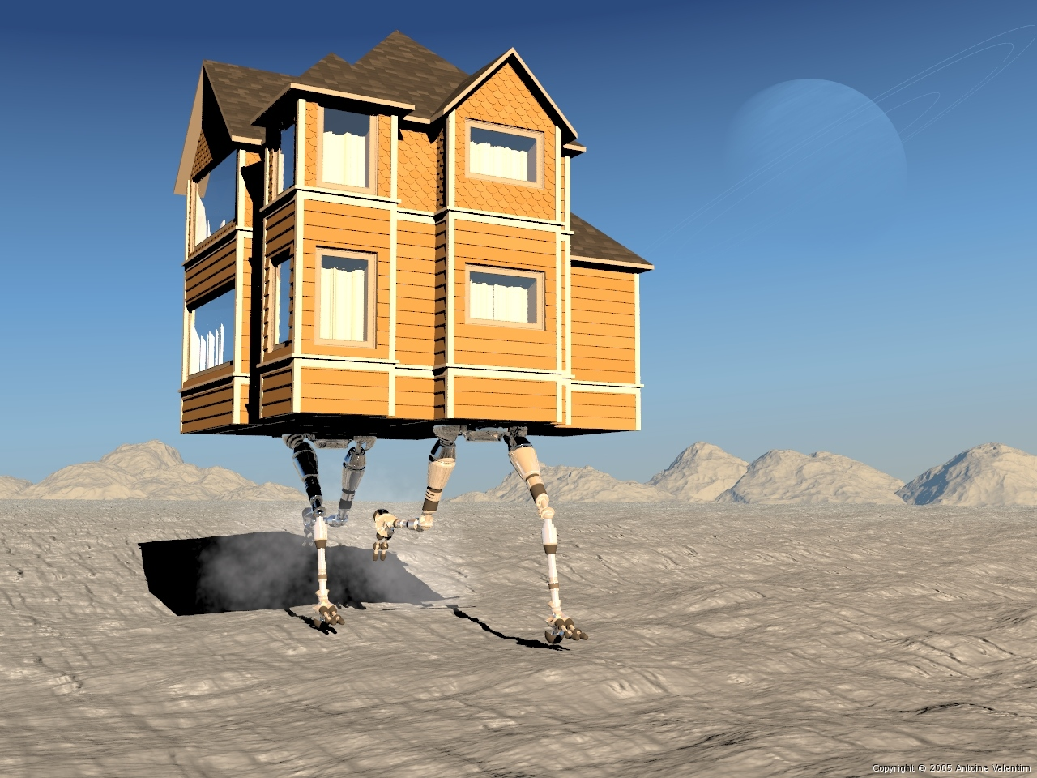

Slide 7
Hebrews 1:3
The Son is the radiance of God’s glory and the exact representation of his being, sustaining all things by his powerful word. After he had provided purification for sins, he sat down at the right hand of the Majesty in heaven.

Slide 8
Leviticus 9:6
And Moses said, “This is the thing that the Lord commanded you to do, that the glory of the Lord may appear to you.”

Slide 9
Leviticus 9:23-24
And Moses and Aaron went into the tent of meeting, and when they came out they blessed the people, and the glory of the Lord appeared to all the people. And fire came out from before the Lord and consumed the burnt offering and the pieces of fat on the altar, and when all the people saw it, they shouted and fell on their faces.

