Slide 1
Making Room
Philippians 2:1-4

Slide 2

Where everybody…

Slide 3

A little kinder than is necessary

Slide 4

Forget yourself long enough…

Slide 5

Sailing rather than rowing…

Slide 6
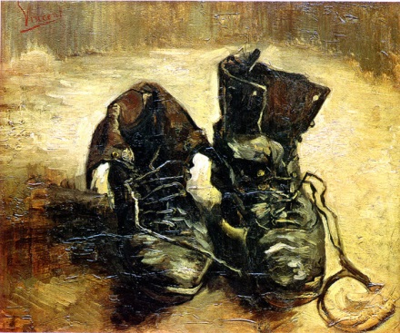
Van Gogh

