Slide 1
Peace?
Nativity

Slide 2


Slide 3


Slide 4
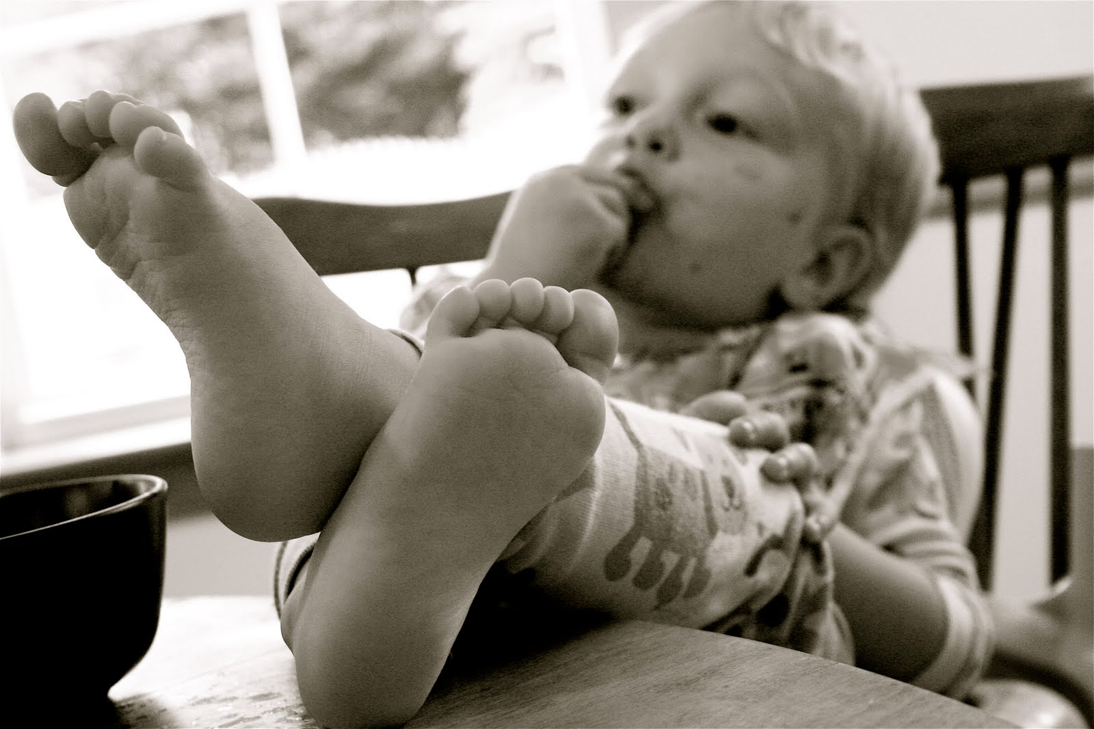

Slide 5


Slide 6
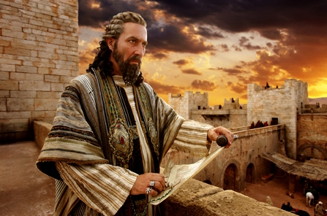
King Herod
‘When King Herod heard this he was disturbed’
Matth.2:3

Slide 7


Slide 8
John 14:27
Peace I leave with you; my peace I give you. I do not give to you as the world gives. Do not let your hearts be troubled and do not be afraid.

