Slide 1
Healthy in God
Robust in love
Philippians 2:5-30

Slide 2
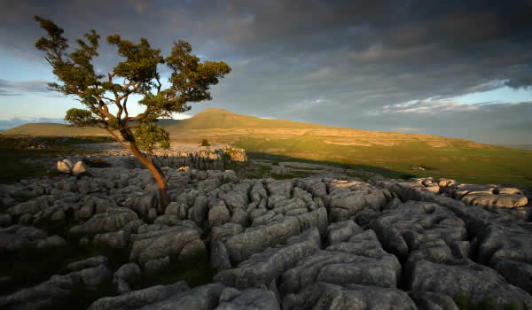
White Scar Caves

Slide 3
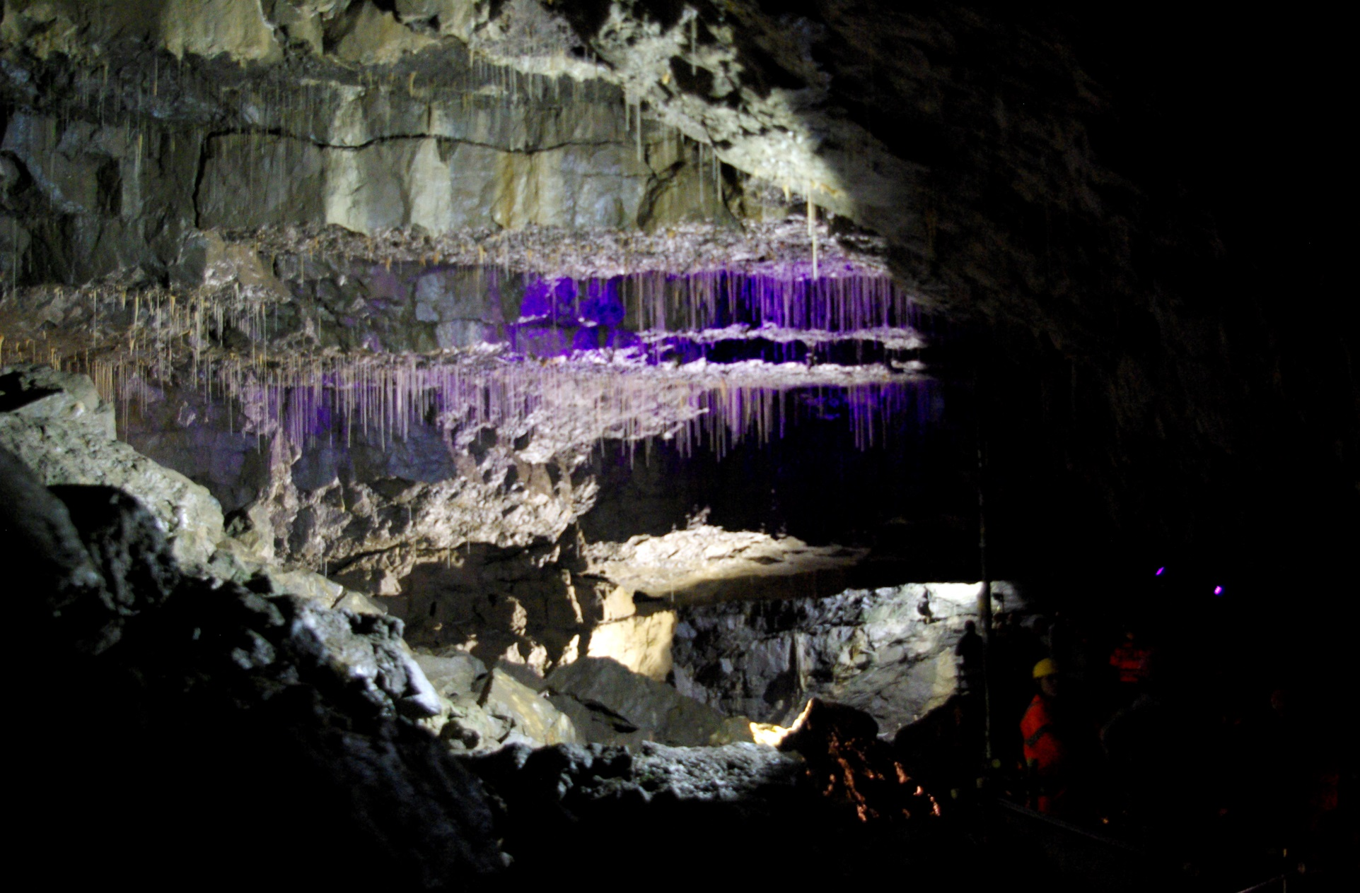
Battlefield Cavern

Slide 4
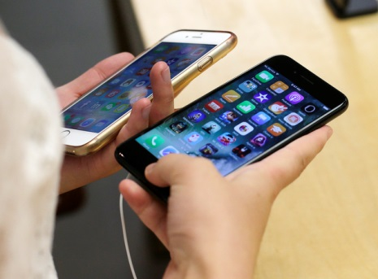
Genuine?

Slide 5

I am Malala…

Slide 6
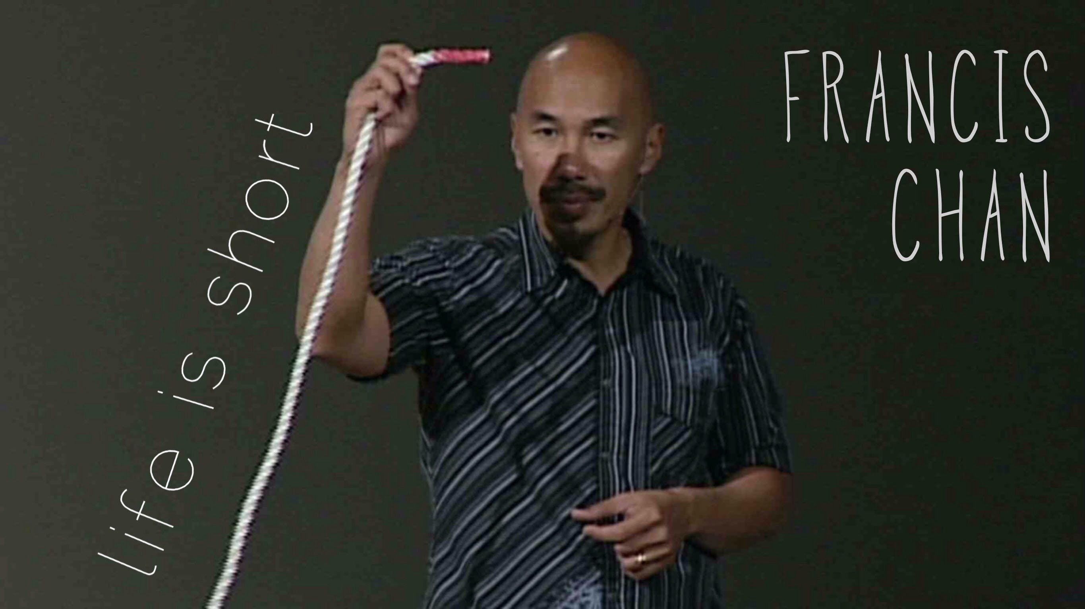
Seeking the things of Jesus!

Slide 7
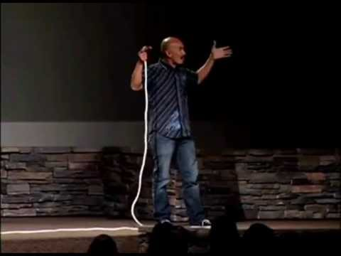
Earth something to be grasped?

